Slide 1
CHAPTER 7.2:
Graphing Equations
Algebra concepts

Slide 2
Objective
Students determine if an ordered pair is a solution of an equation.
Students will graph equations in two variables.

Slide 3


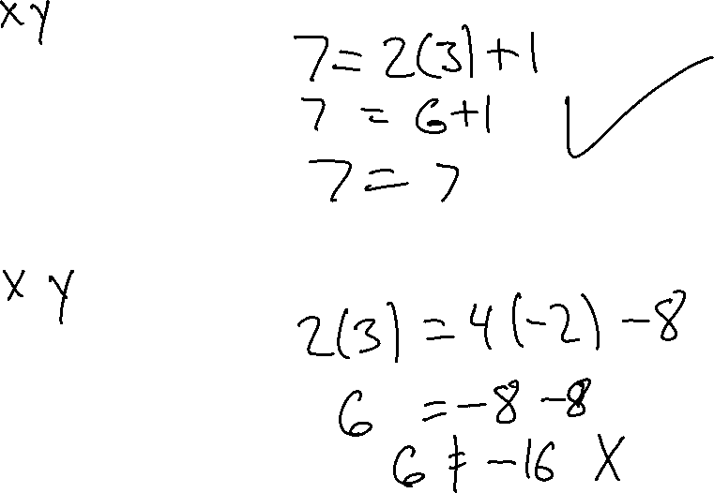
$$Examples$$
Is (3, 7) a solution of $y=2x+1$
Is (-2, 3) a solution of $2y=4x−8$

Slide 4

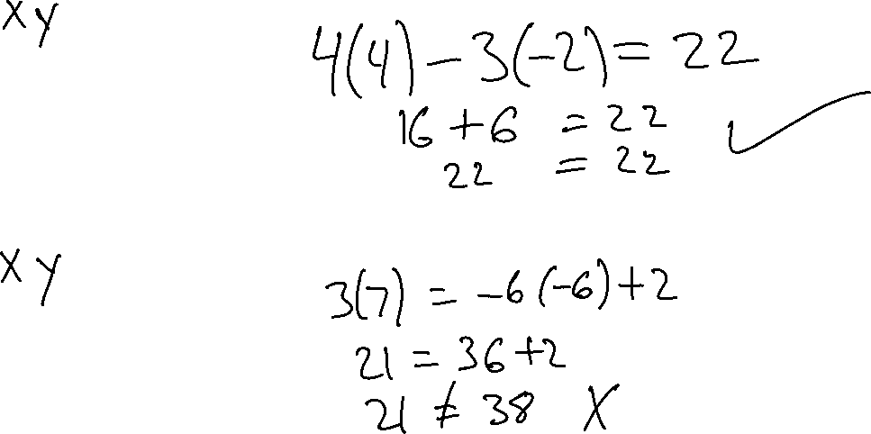
$$Examples$$
Is (-2, 4) a solution of $4y−3x=22$
Is (-6, 7) a solution of $3y=−6x+2$

Slide 5
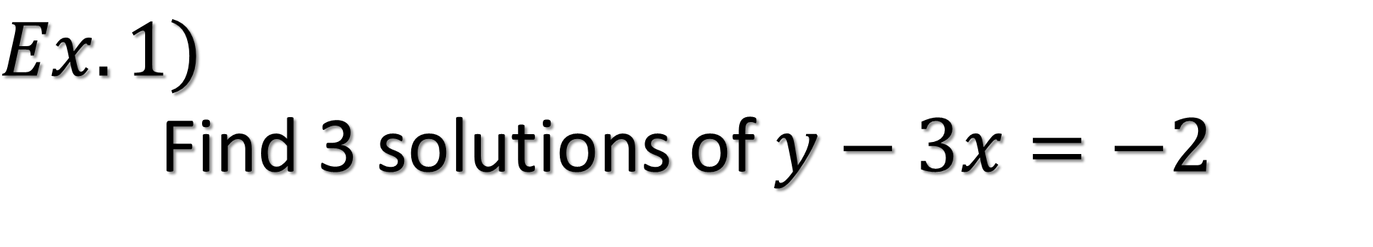
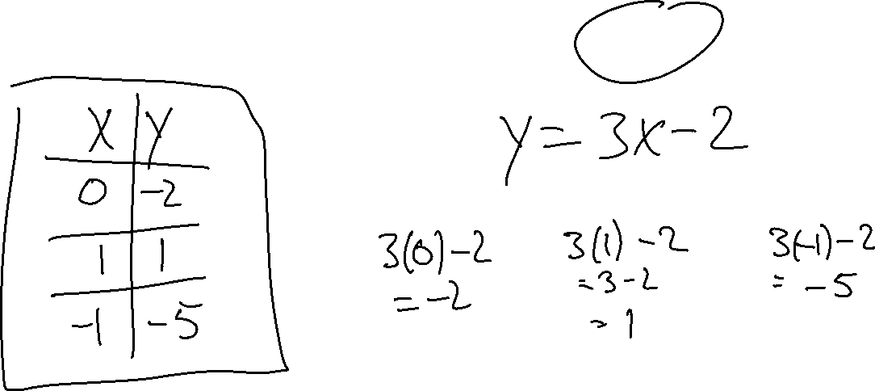
$$Ex.1)$$
Find 3 solutions of $y−3x=−2$

Slide 6
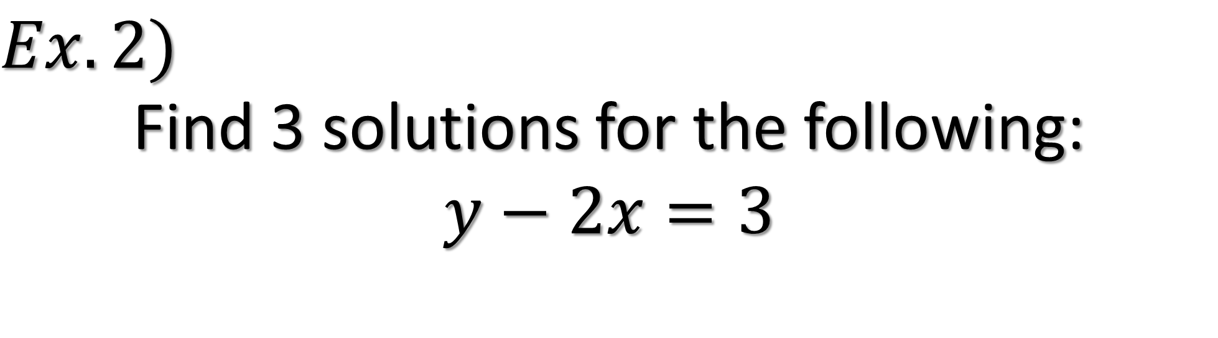
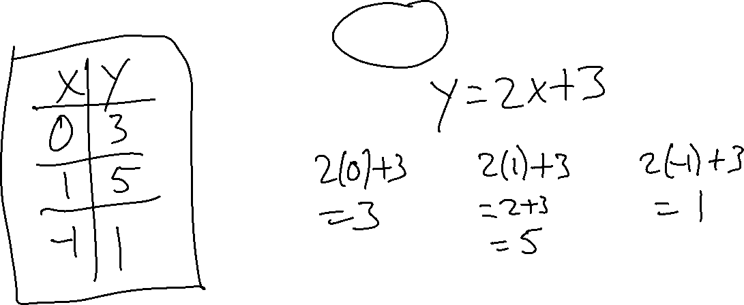
$$Ex.2)$$
Find 3 solutions for the following:
$$y−2x=3$$

Slide 7
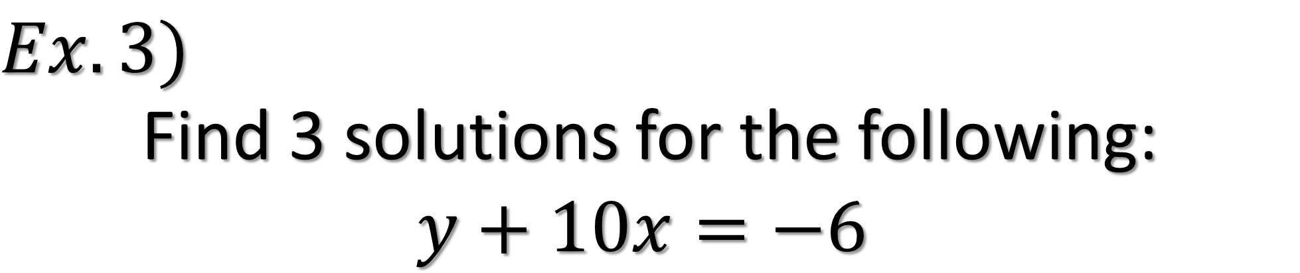
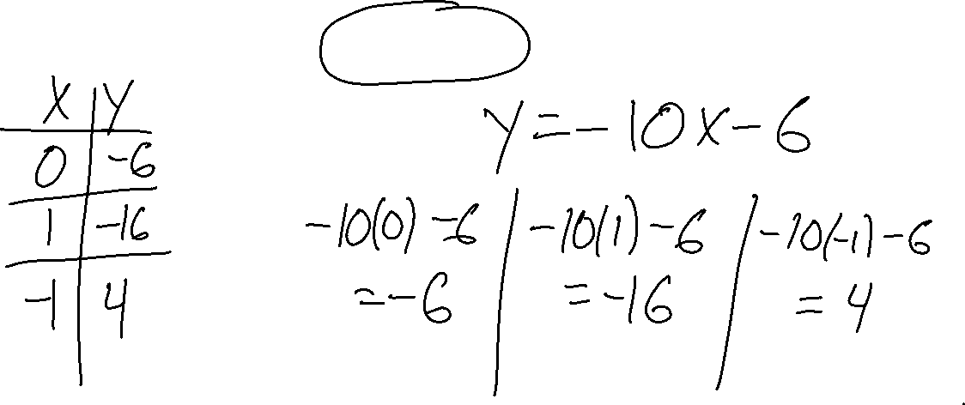
$$Ex.3)$$
Find 3 solutions for the following:
$$y+10x=−6$$

Slide 8
GRAPHING
To make a graph you have to find at least 3 solutions for an equation.
  Plot the three points
  Connect them with a straight line

Slide 9
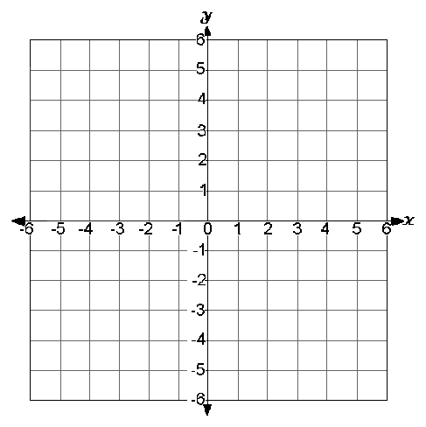
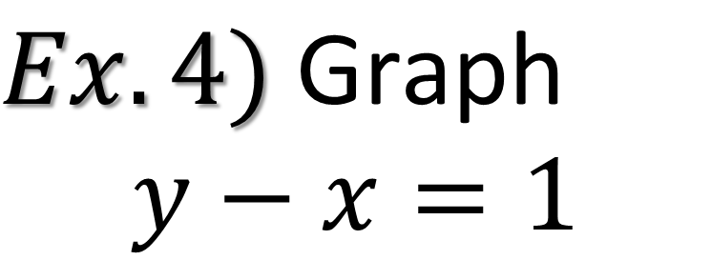
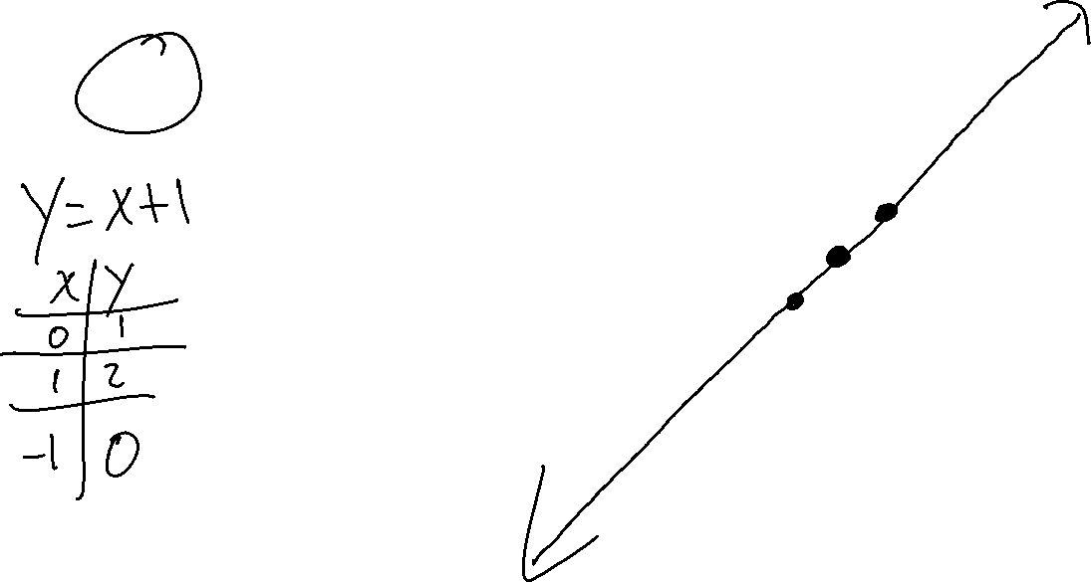
$$Ex.4) \text{Graph}$$
$$y−x=1$$

Slide 10
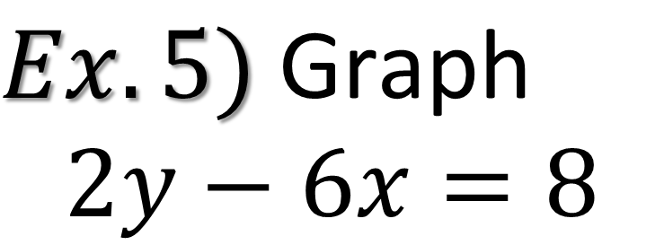
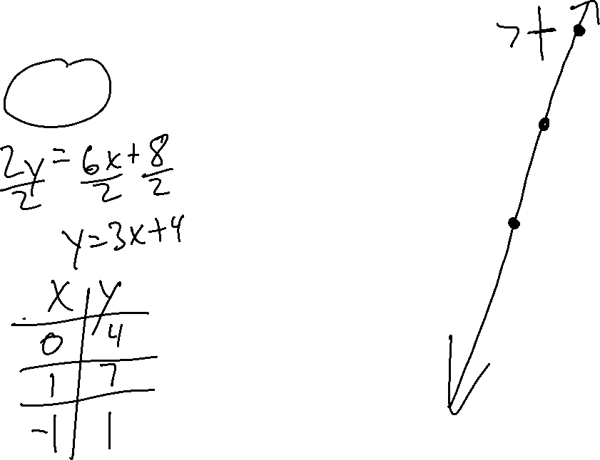
$$Ex.5) \text{Graph}$$
$$2y−6x=8$$

Slide 11
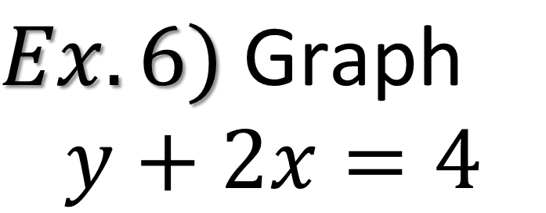
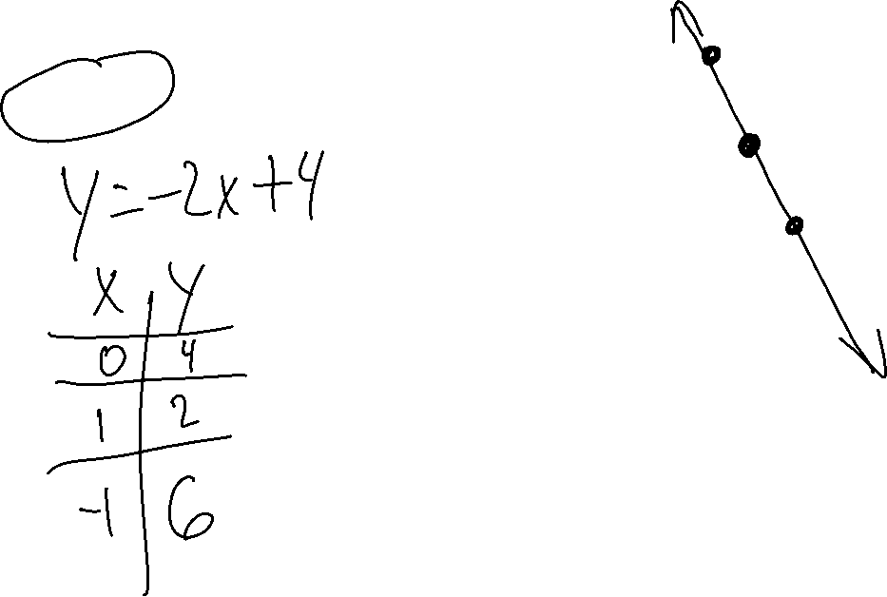
$$Ex.6) \text{Graph}$$
$$y+2x=4$$

